Slide 2
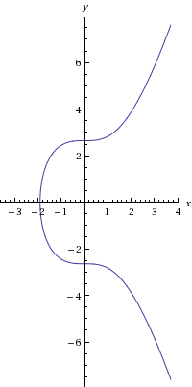
Elliptic Curve Asymmetric Cryptosystems
Elliptic curve discrete logarithm problem: given points P and Q on an elliptic curve, it is hard to find an integer k such that Q = kP (unless you know trapdoor).
y² = x³ – 7 (mod p)

Slide 3
 | RSA | ECC
Discovery | 1977 (previously discovered in 1969 by GHCQ and perhaps earlier by NSA) | 1985 (adoption limited until ~2005)
“Hard” Problem | Factoring | Discrete Log on Elliptic Curve
Key Size (~112-bit) | 2048 bits (768 bits broken) | 224 bits (112 bits broken)
Backdoor Risk | None | Curves selected by NSA
Quantum Computing Risk | Known fast factoring algorithms (Shor’s) | Similar (variation of Shor’s algorithm solves Discrete Log)
Implementation Challenges | Avoiding weak keys, timing side channels | Fast operations on elliptic curves, leaks on invalid inputs

Slide 4
 | RSA | ECC | Lattice Ciphers
Discovery | 1977 | 1985 (adoption limited until ~2005) | 1996
“Hard” Problem | Factoring | Discrete Log on Elliptic Curve | Lattice Problems (e.g., closest vector)
Key Size (~112-bit) | 2048 bits (768 bits broken) | 224 bits (112 bits broken) | 1,000,000 bits
Backdoor Risk | None | Curves selected by NSA | Little
Quantum Computing Risk | Known fast factoring algorithms (Shor’s) | Similar (variation of Shor’s algorithm solves Discrete Log) | Only if P = NP
Implementation Challenges | Avoiding weak keys, timing side channels | Fast operations on elliptic curves, leaks on invalid inputs | Only simple arithmetic (but 10Ks of them)

Slide 5
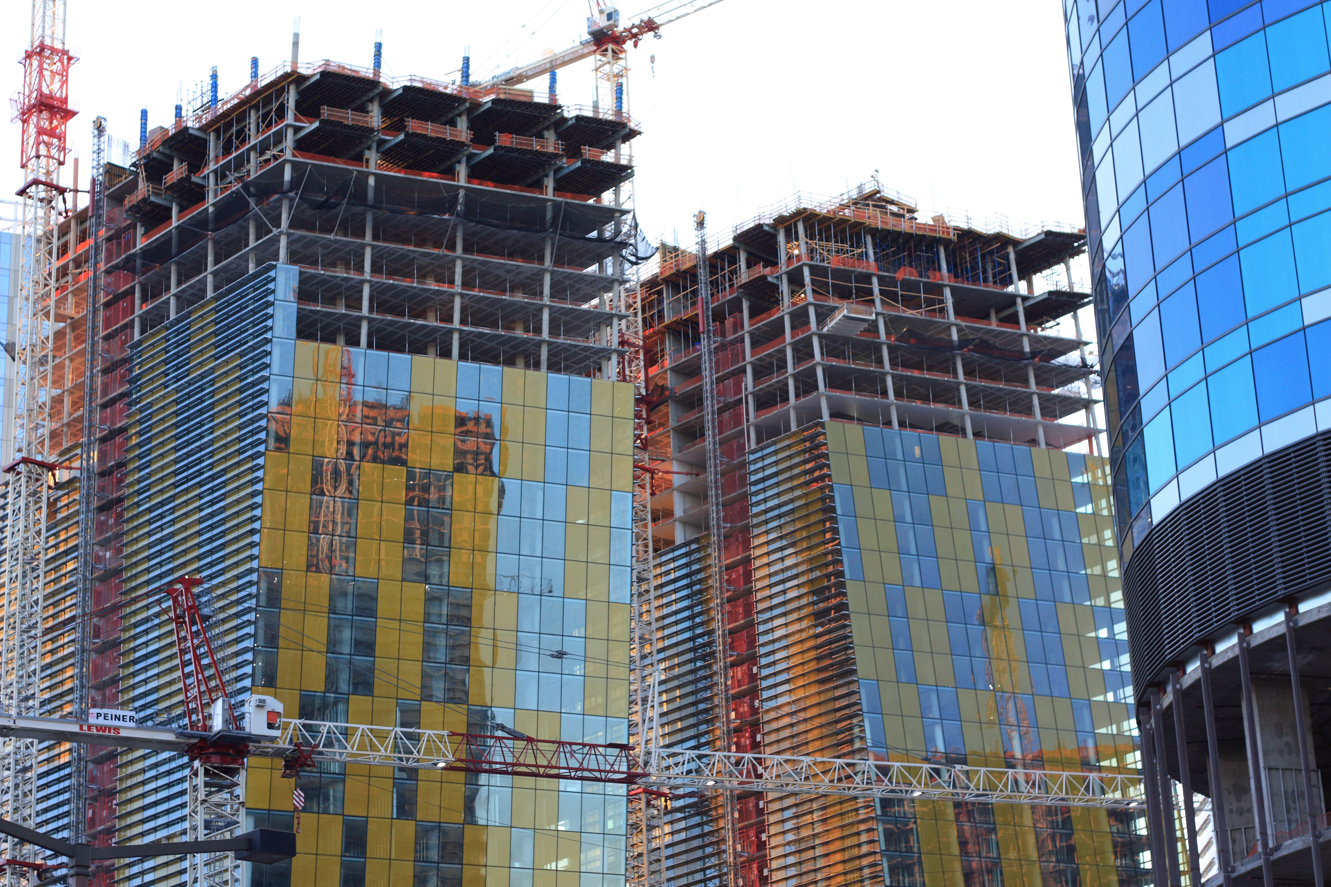
Applications of Asymmetric Cryptosystems

Slide 6
Using Asymmetry: Signatures
Alice
Bob
Generates KU_{B} and KR_{B}
Publishes KU_{B}
Verifies message is from Bob using his public key
E
Signed Message
D
Verified
Message
Message
Insecure Channel
KU_{B}
KR_{B}
Over 1000x slower than AES! (with both RSA and ECC)
What if we need to sign long (bigger than n ~ 2048 bits) messages?

Slide 7
Message Digests
Alice
Bob
H
=
Message
Signed Message
Verified
Message
Digest
E
D
H
Verified
Message
Message
Message Digest
KU_{B}
KR_{B}
H is a cryptographic hash function:
one-way: given H(x) cannot find preimage x
strong collision-resistant:
hard to find pair x and y where H(x) = H(y)

Slide 8
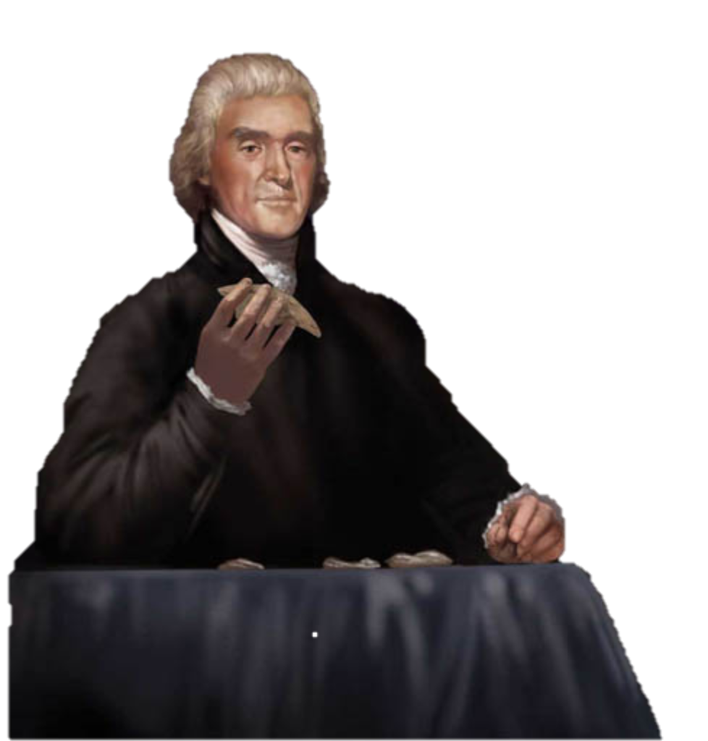
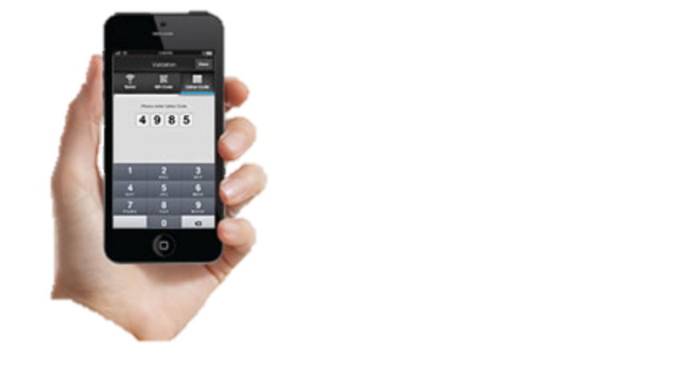
Authentication
petitions.gov
Insecure Channel
How does TJ know he’s really talking to petitions.gov?
How can he establish a secure channel to transmit password?

Slide 9
Simple Login Protocol
petitions.gov
Eve can’t decrypt without KR_{petitions}.
E_{KUpetitions}(“tj” + password)
D_{KRpetitions}(c)

Slide 10
Getting Public Keys
Public keys only useful if you know you have the right one!
Secure on-line directory?
keys.gov
What is petitions.gov public key?
KU_{petitions}

Slide 11
Moving Directory Off-Line
TrustMe.com
petitions.gov, KU_{Petitions}
C_{P} = KR_{TrustMe}[“petitions.gov”, KU_{Petitions}]
TJ
C_{P}
Verifies using KU_{TrustMe}
Petitions

Slide 12
Anyone use this?

Slide 13


Slide 14
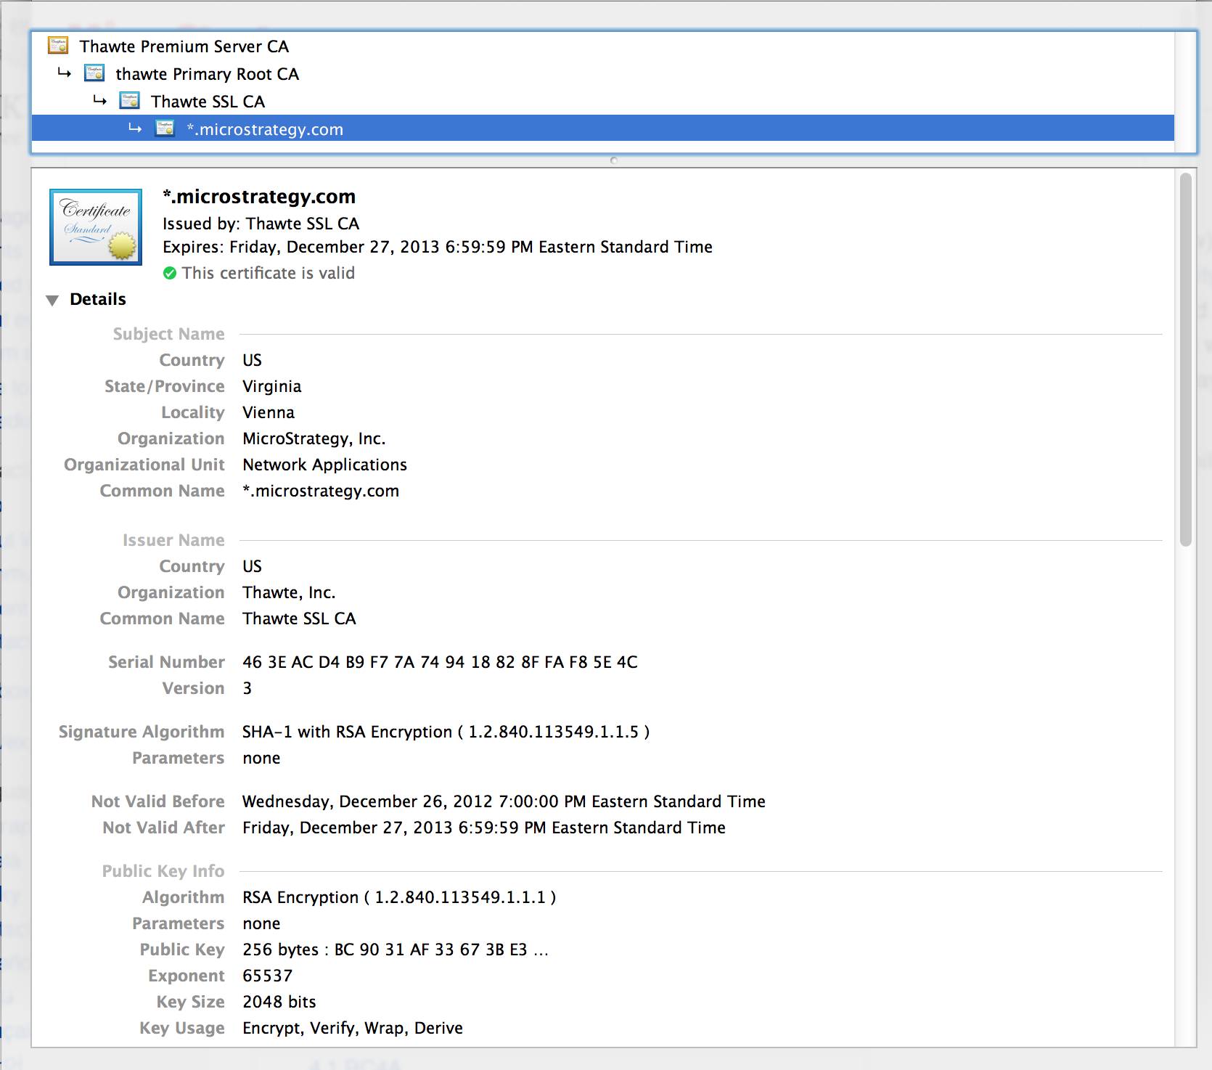
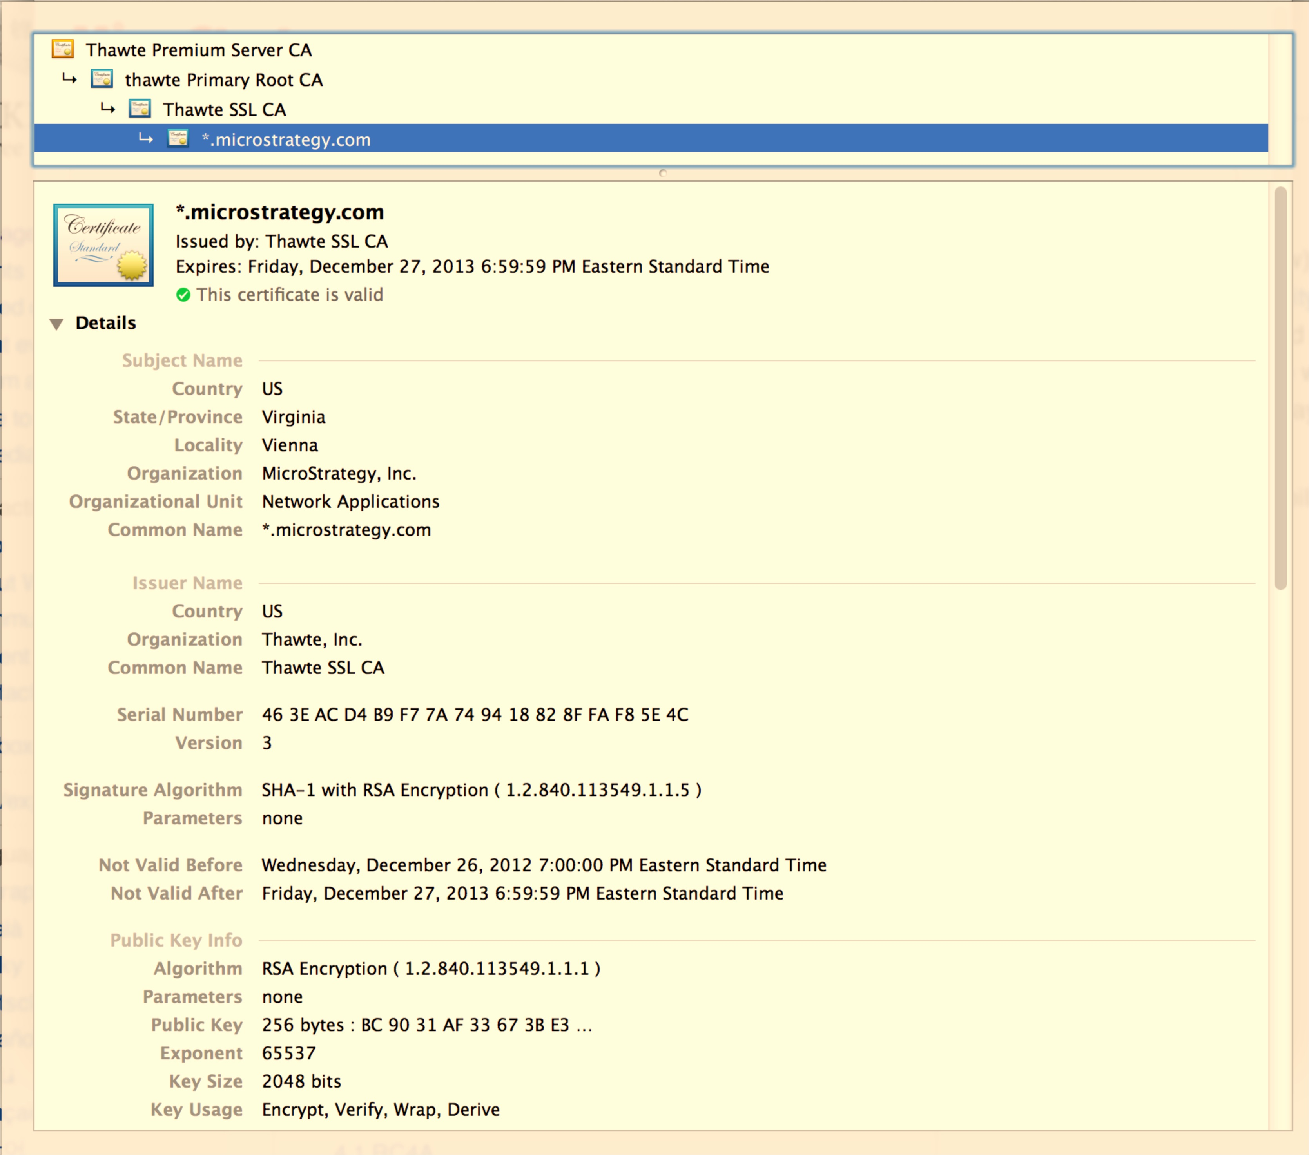

Slide 15
SSL (Secure Sockets Layer) Simplified TLS Handshake Protocol
Client
Server
Hello
Verify Certificate using KU_{CA}
Check identity matches URL
Generate random K
KR_{CA}[Server Identity, KU_{S}]
Decryptusing KR_{S}
E_{KUS} (K)
Secure channel using K

Slide 16
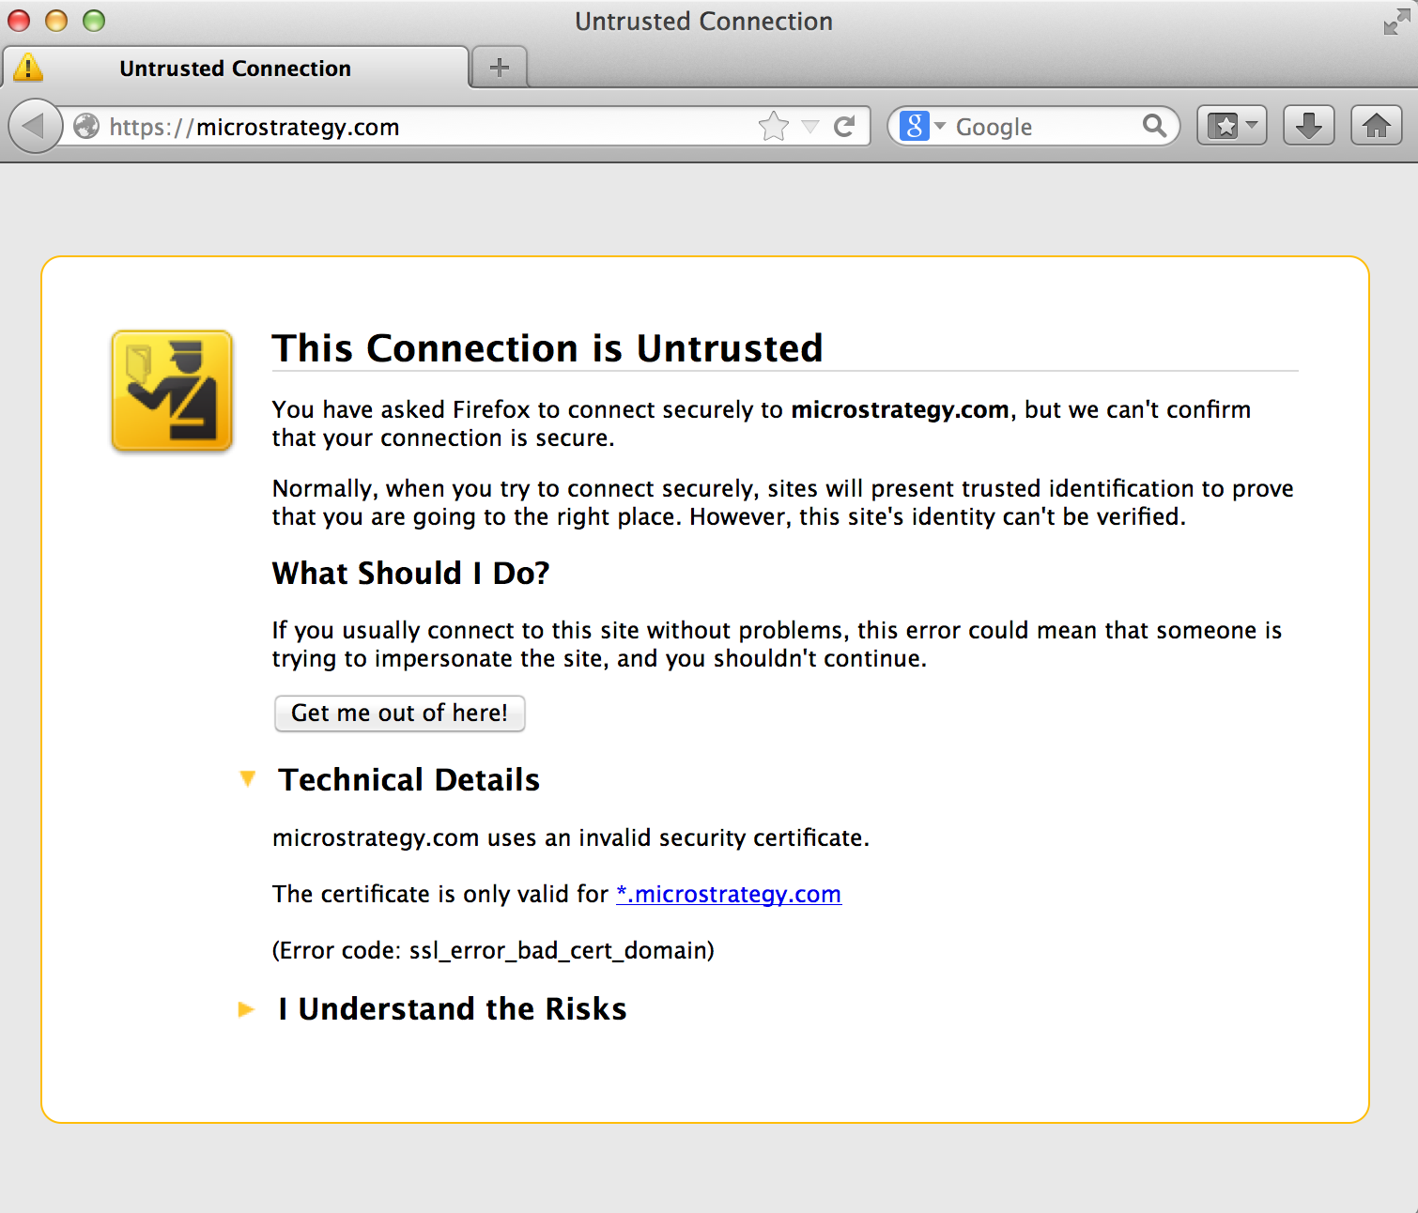

Slide 17
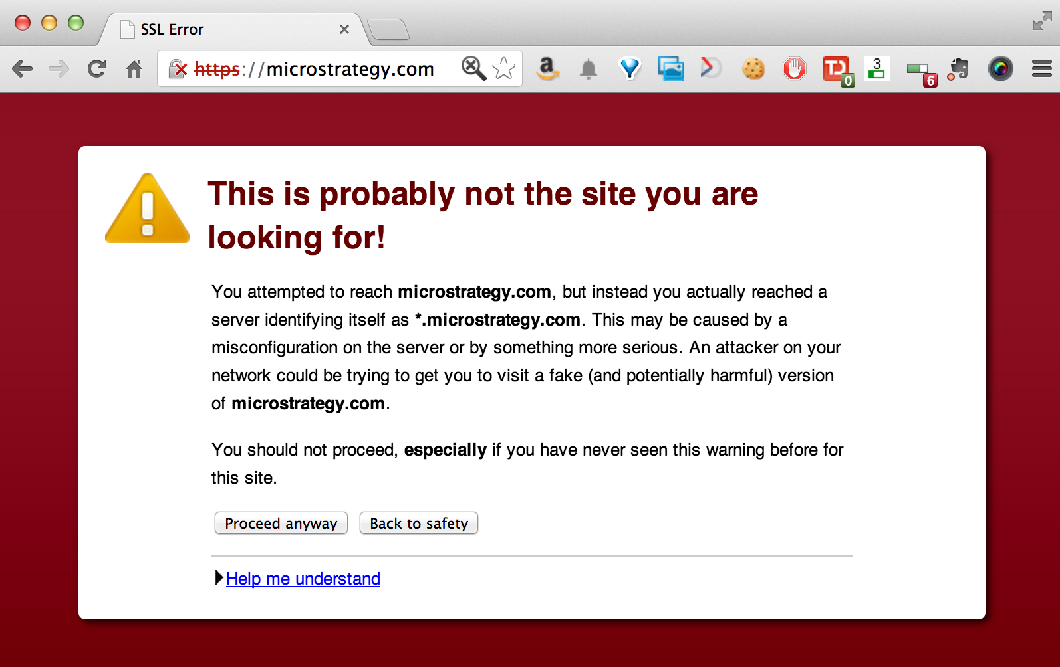

Slide 18
SSL (Secure Sockets Layer) Simplified TLS Handshake Protocol
Client
Server
Hello
Verify Certificate using KU_{CA}
Check identity matches URL
Generate random K
KR_{CA}[Server Identity, KU_{S}]
How did client get KU_{CA}?
Decryptusing KR_{S}
E_{KUS} (K)
Secure channel using K

Slide 19
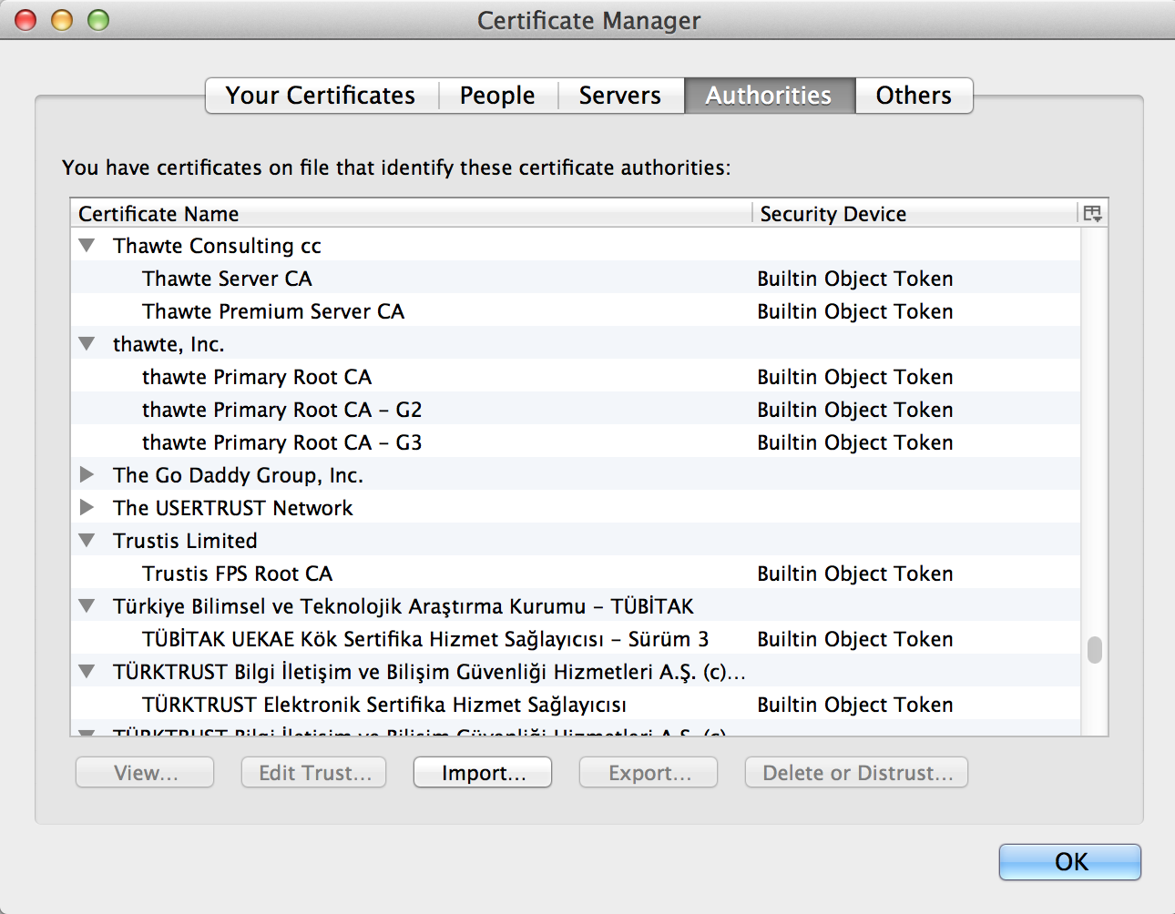

Slide 20
Certificates
How does VarySign decide if it should give certificate to requester?
VarySign.com
petitions.gov, KU_{Petitions}
C_{P} = KR_{VarySign}[“petitions.gov”, KU_{Petitions}]
TJ
C_{P}
Verifies using KU_{VarySign}
Petitions

Slide 21
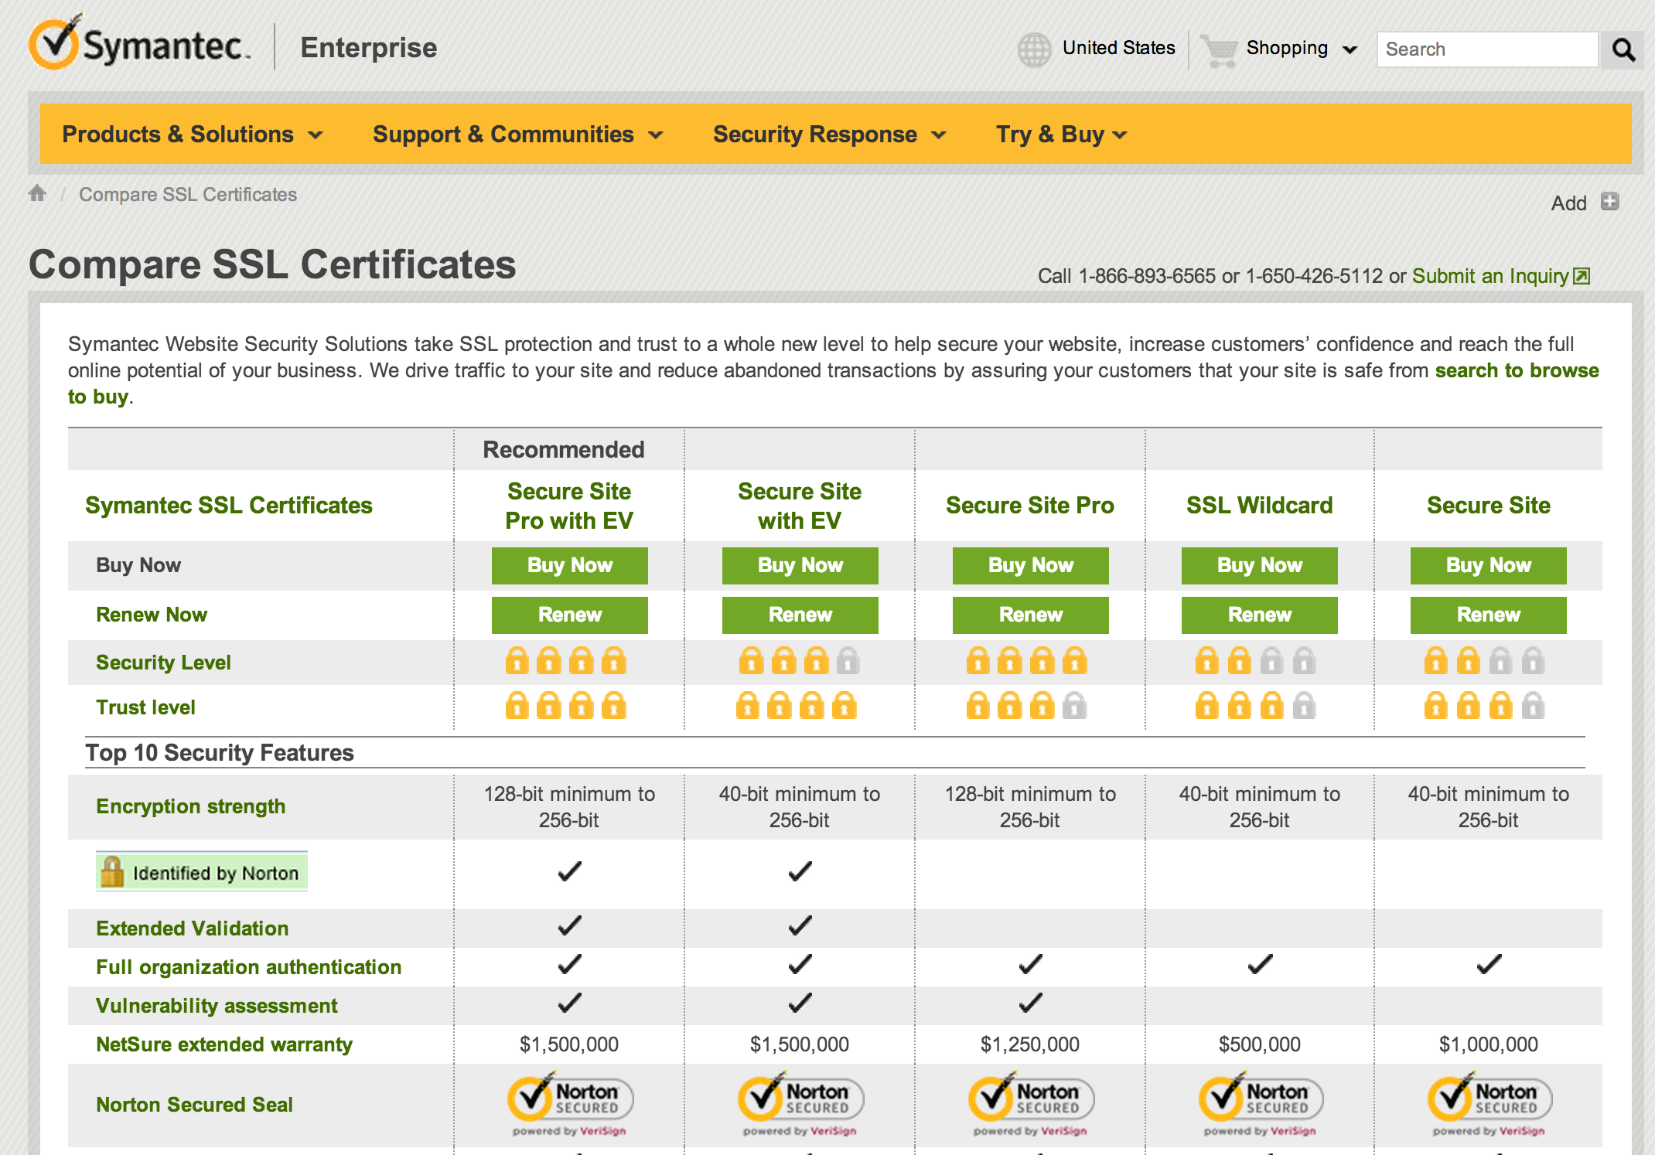
$1500 for 1 year
$399

Slide 22
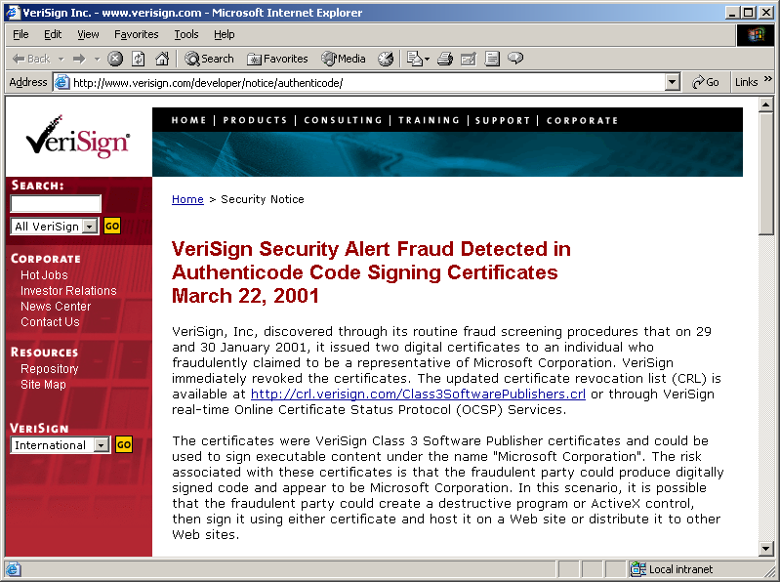
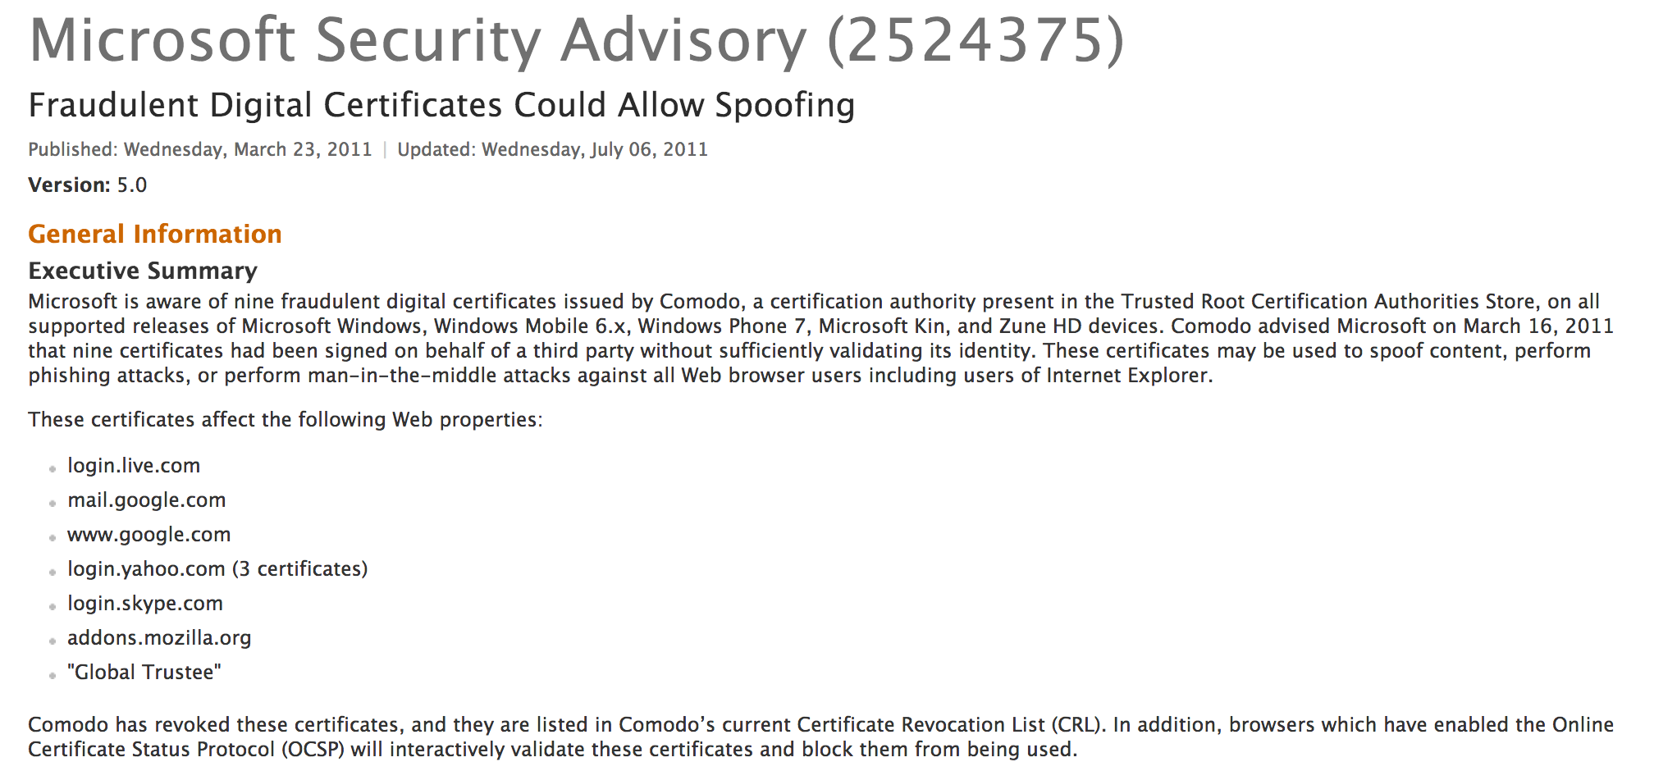
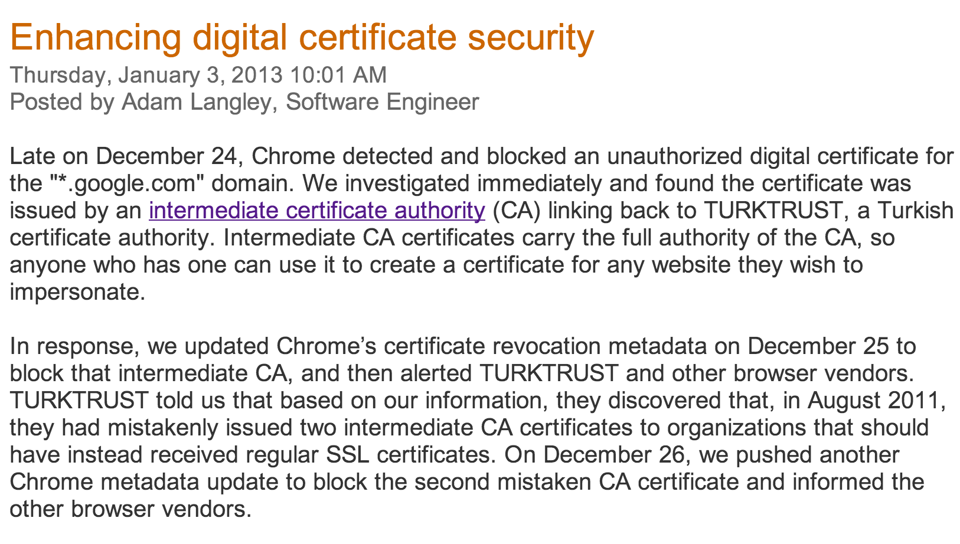

Slide 23
Limiting Damage
VarySign.com
petitions.gov, KU_{Petitions}
C_{P} = KR_{VarySign} [“petitions.gov”, cert ID, Expiration, KU_{Petitions}]
TJ
C_{P}
Verifies using KU_{VarySign}
Petitions

Slide 24
Certificate Revocation
VarySign.com
Certificate Revocation List (CRL)
<cert ID, date>
…
petitions.gov, KU_{Petitions}
C_{P} = KR_{VarySign}[“petitions.gov”, cert ID, Expiration, KU_{Petitions}]
Client
C_{P}
Verifies using KU_{VarySign}
Petitions

Slide 25
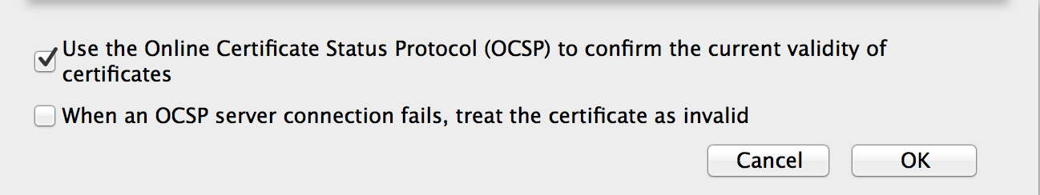
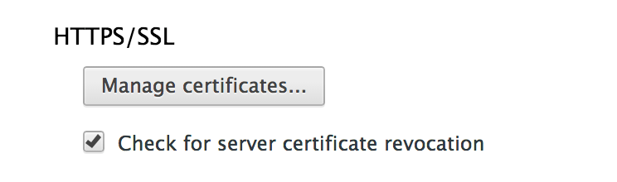
CRL Checking
Mozilla Firefox
Google Chrome
On-line checking is expensive and may fail
Attacker-in-the-middle can make it fail

Slide 26
SSL (Secure Sockets Layer) Simplified TLS Handshake Protocol
Client
Server
Hello
Actual TLS has some extra steps:
Negotiate versions
Agree on which ciphers to use (many options, but beware!)
Can authenticate client also
Verify Certificate using KU_{CA}
Check identity matches URL
Generate random K
KR_{CA}[Server Identity, KU_{S}]
Decryptusing KR_{S}
E_{KUS} (K)
KU_{S} [K]
Secure channel using K

Slide 27
Summary
Many useful applications require asymmetry
Confidentiality without shared key, signatures
Others we will cover next week
Asymmetric cryptosystems can be built using hard problems in number theory with trapdoors: RSA (factoring), ECC (discrete log)
Asymmetric ciphers are very expensive: need to combine with hashes and symmetric crypto

Slide 28
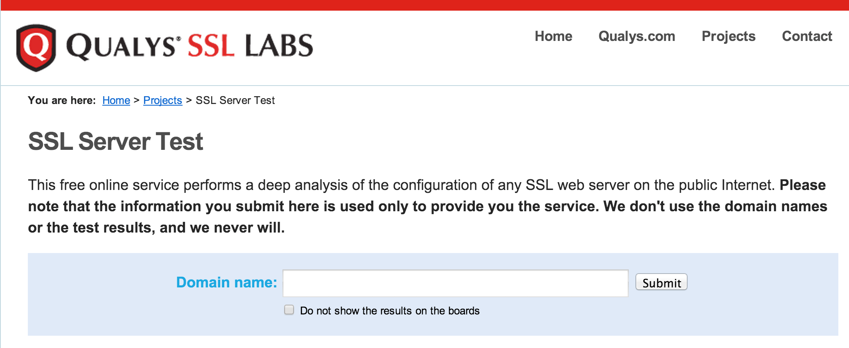
SSL Test

Slide 29
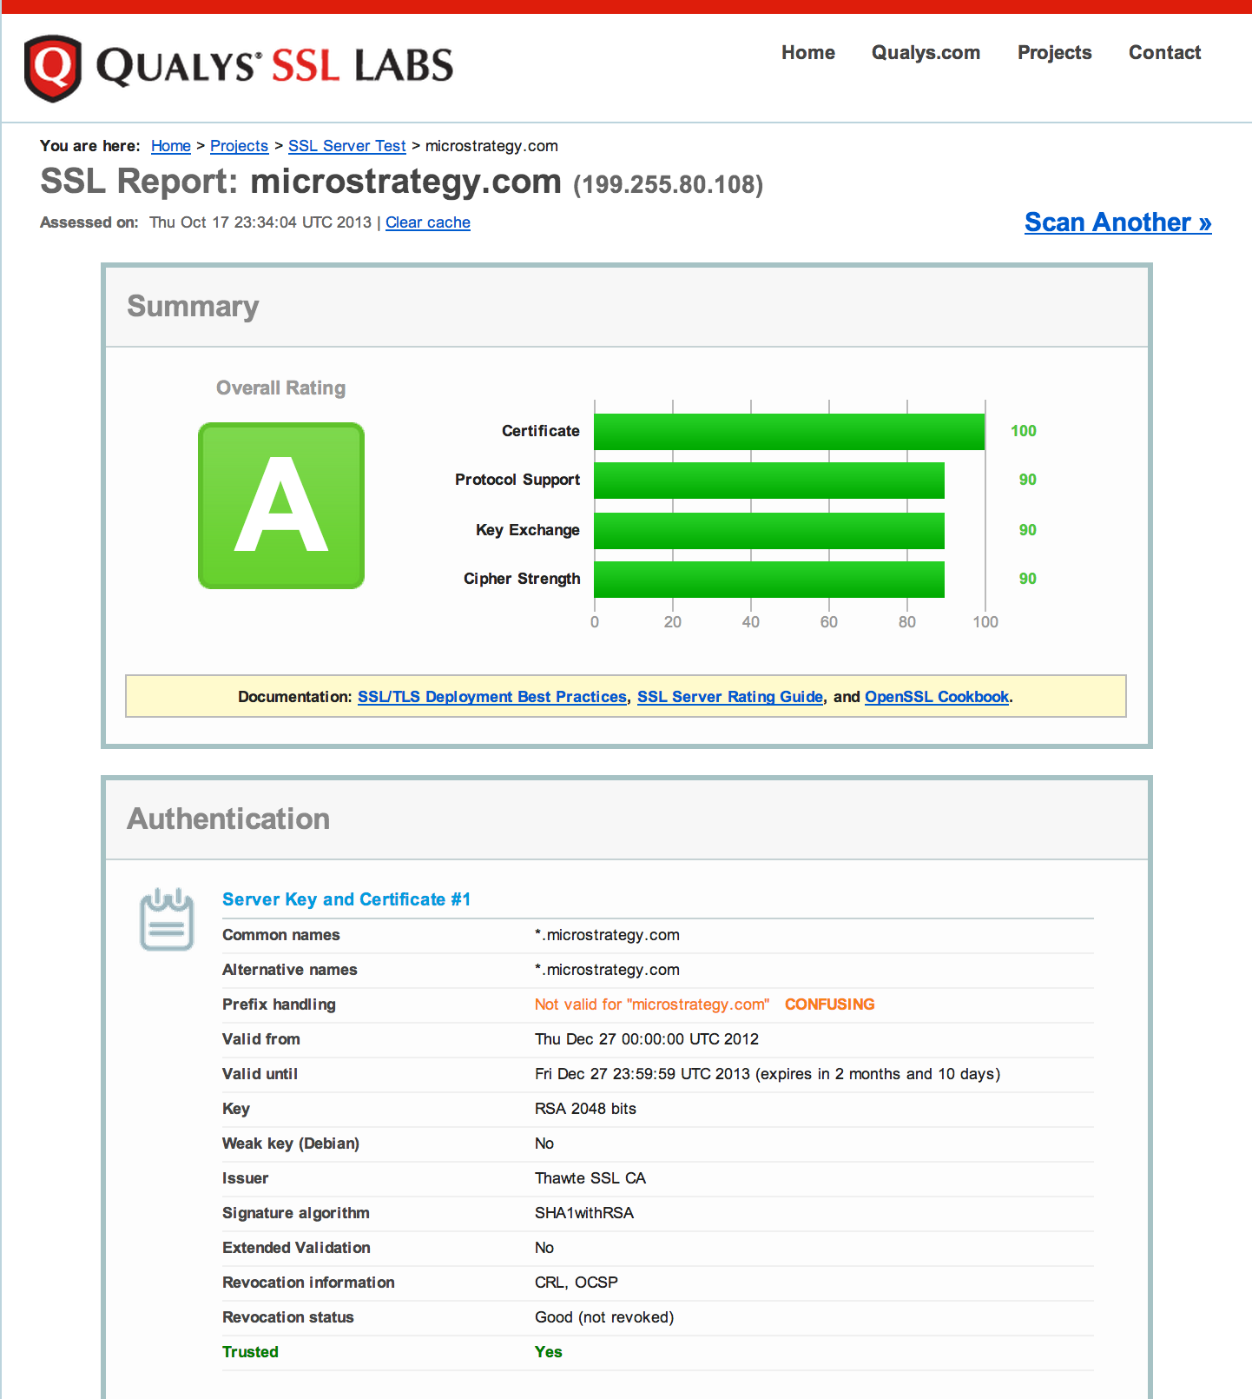
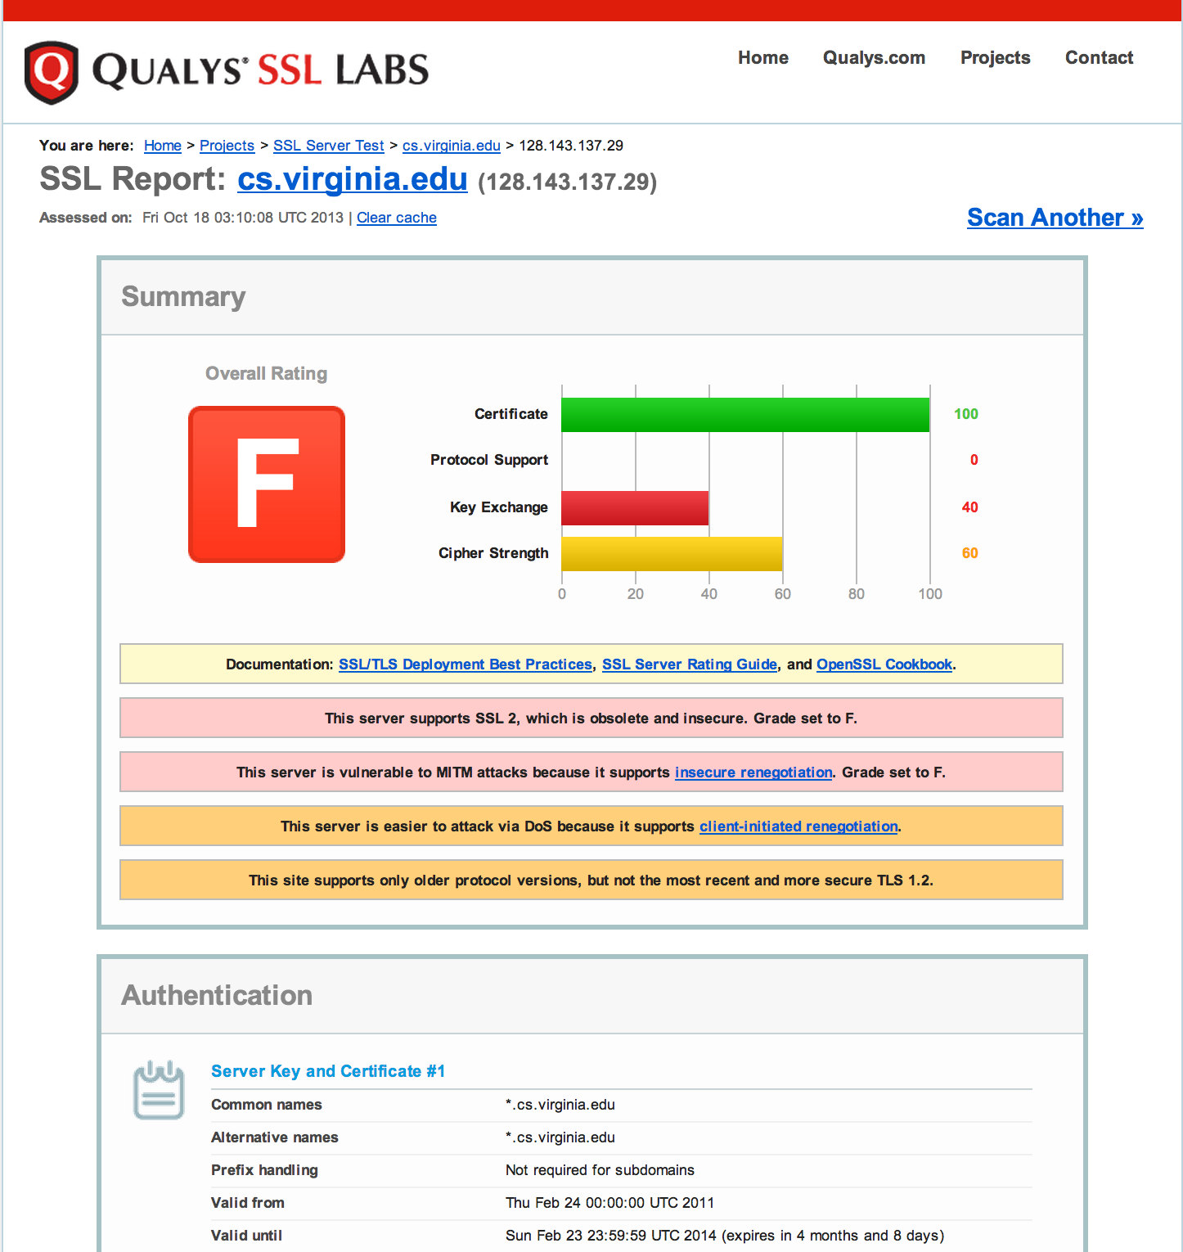

Slide 30
How can something digital be scarce?

Slide 31
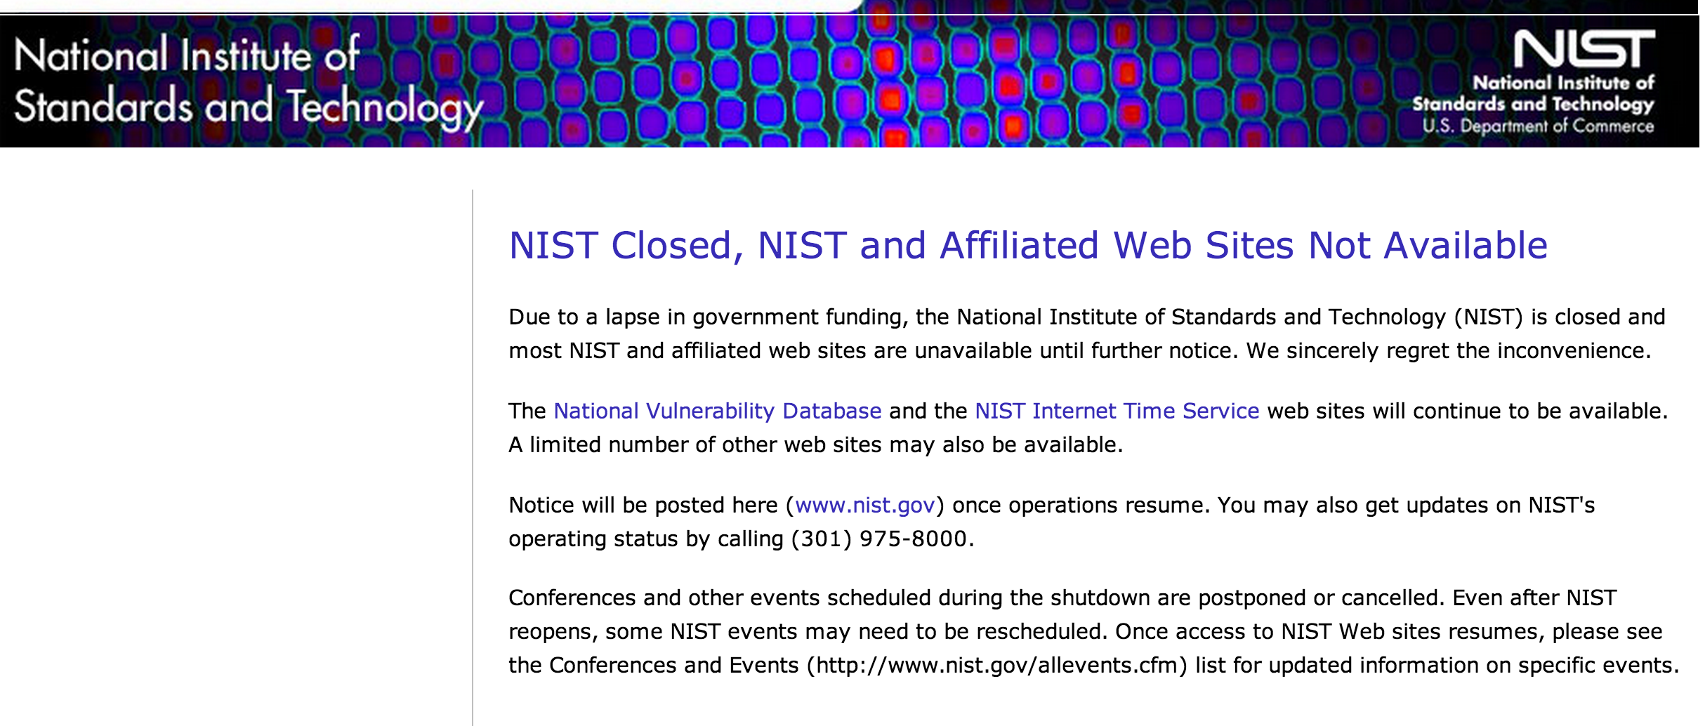
NIST SP 800-90: Recommendation for Random Number Generation Using Deterministic Random Bit Generators (2006)

Slide 32
Dual-EC PRNG
s₀ ⬅ physical randomness
P and Q are points on an elliptic curve
s_{i}
r_{i} = φ(s_{i} ×Q)
s_{i +1}= φ(s_{i} ×P)
16 least significant bits of r_{i}’s x-coordinate
Update Internal State
Generate Output Bits

Slide 33
Elliptic Curves
y² = x³ – 7 (mod p)
Discrete values: x and y are integers!
Addition: P + Q
= intersection of curve with line
through P and Q
Multiplication: repeated addition
kP = P + P + … + P
Elliptic Curves are primarily used in asymmetric crypto – but also in Dual EC PRNG

Slide 34
Elliptic Curves
y² = x³ – 7 (mod p)
P + Q
Discrete values: x and y are integers!
P
Addition: P + Q
= negate intersection of curve with line through P and Q
Multiplication: repeated addition
kP = P + P + … + P
Q

Slide 35
Elliptic Curves
y² = x³ – 7 (mod p)
Elliptic curve discrete logarithm problem: given points P and Q on an elliptic curve, it is hard to find an integer k such that Q = kP.
P + Q = point on curve where line PQ intersects
kP = P + P + … + P (multiplication is just repeated addition)

Slide 36
Curve Used by Dual-EC PRNG
NIST P-256
y² = x³ + ax + b (mod p)
p = 2²⁵⁶ − 2²²⁴ + 2¹⁹² + 2⁹⁶ − 1
a = p − 3 = 115792089210356248762697446949407573530086143415290314195533631308867097853948
b = 41058363725152142129326129780047268409114441015993725554835256314039467401291
Elliptic curve operations are expensive! Dual-EC PRNG is 1000x slower than strong PRNG’s built using symmetric ciphers.

Slide 37
Why would anyone use Elliptic Curves as basis for PRNG?
Easier to plant a back-door in it than designs based on symmetric ciphers
Can be used to provide provable security properties based on number theory
But not done for Dual EC PRNG

Slide 38
Dual-EC PRNG Proposed as NIST standard (2005)
s₀ ⬅ randomness
P and Q are (random?) points on P-256.
s_{i}
r_{i} = φ(s_{i} ×Q)
s_{i +1}= φ(s_{i} ×P)
16 least significant bits of r_{i}’s x-coordinate
Update Internal State
Generate Output Bits

Slide 39
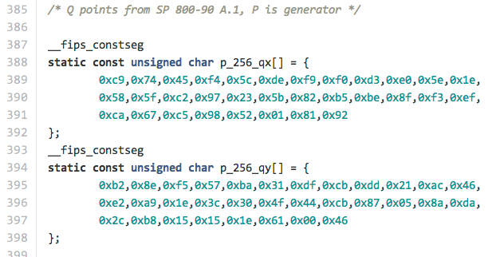
Image credit: Matthew Green
OpenSSL-FIPS Implementation (using NIST P and Q values)

Slide 40
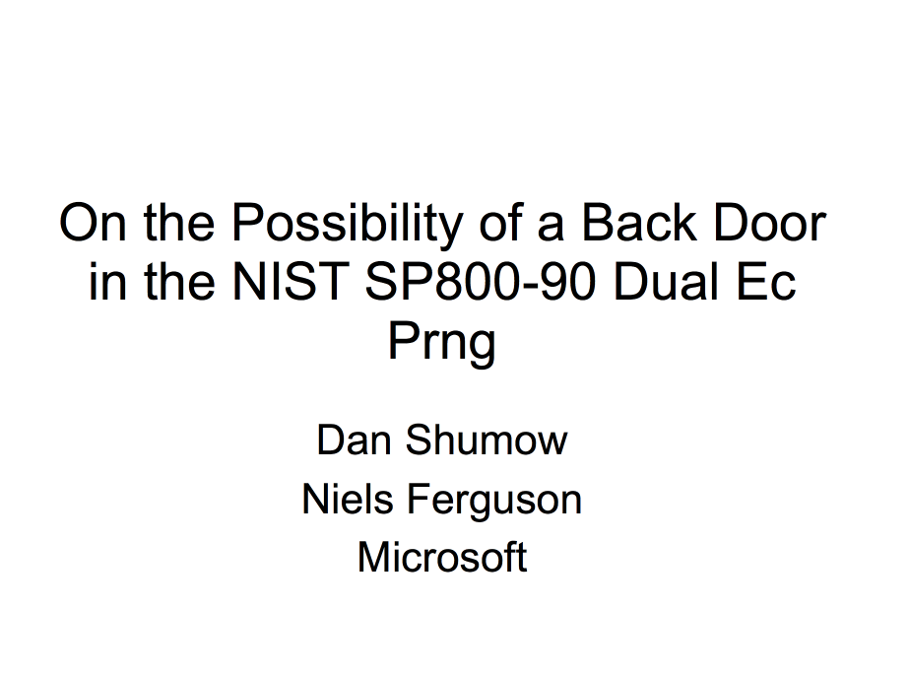
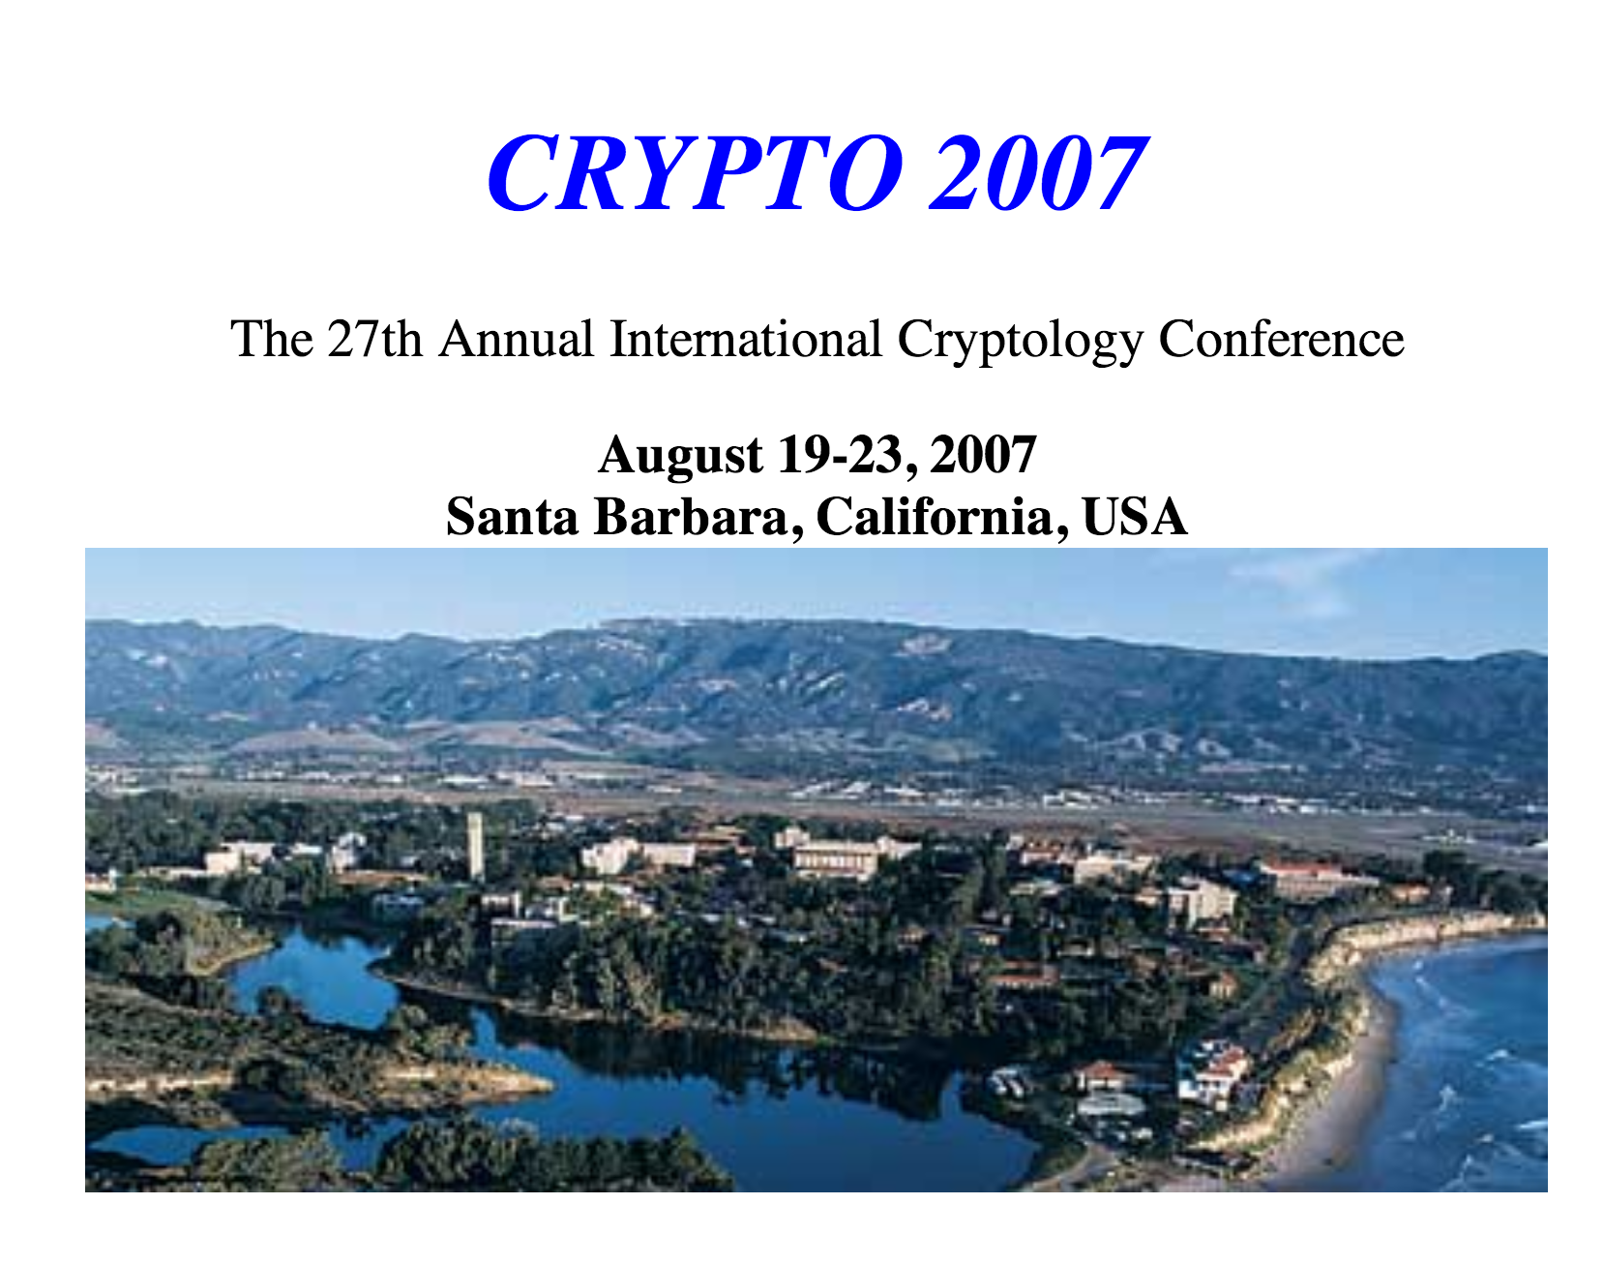
“Rump session” talk at CRYPTO 2007:
You can choose Q such that: Q = dP
then, it is easy to find e such that: P = eQ
and then easy to learn state of PRNG from just one output!

Slide 41
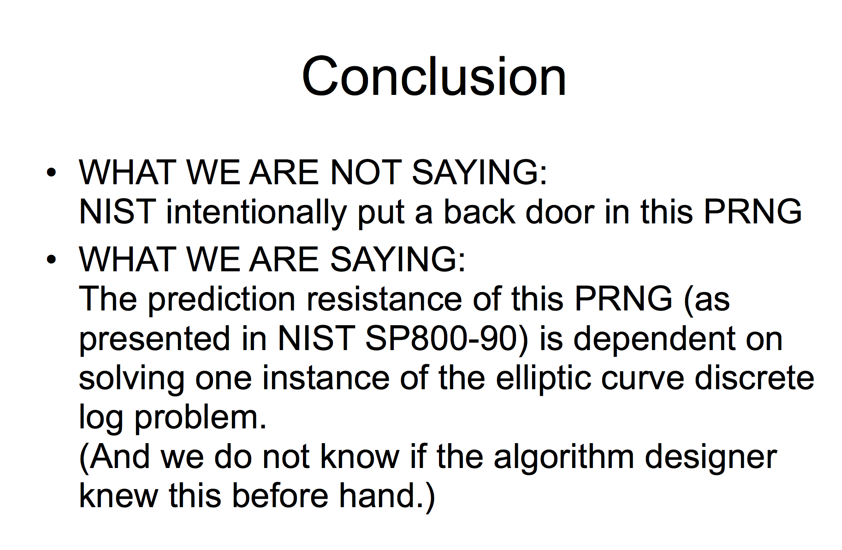
Shumow and Ferguson’s conclusion:

Slide 42
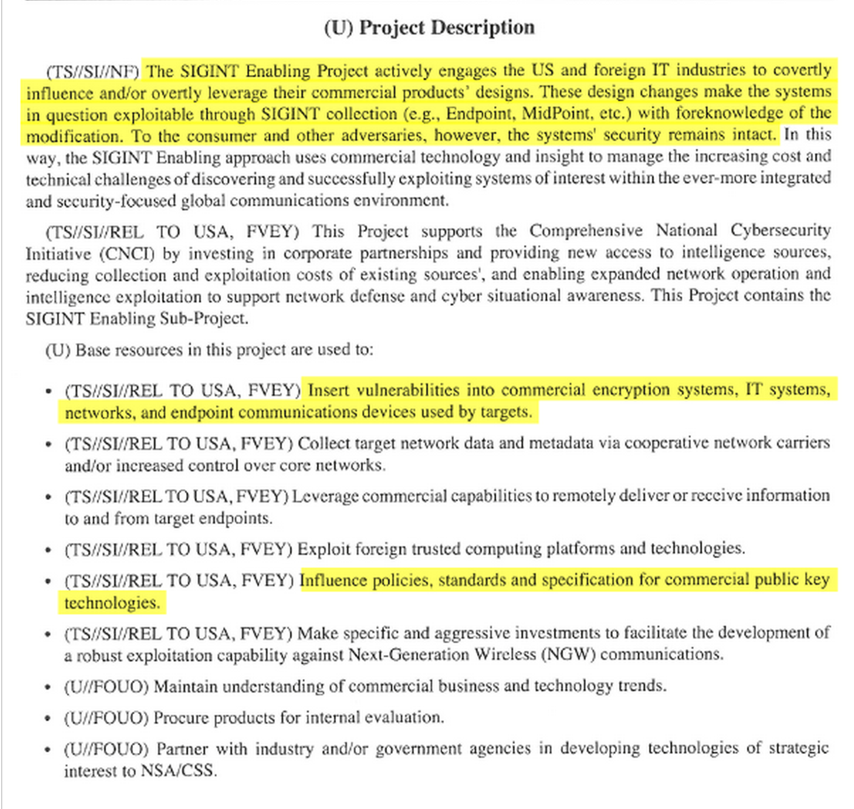
Snowden Leak (5 September 2013)
2013 Intelligence Budget Request ($250M)
2013 Intelligence Budget Request

Slide 43
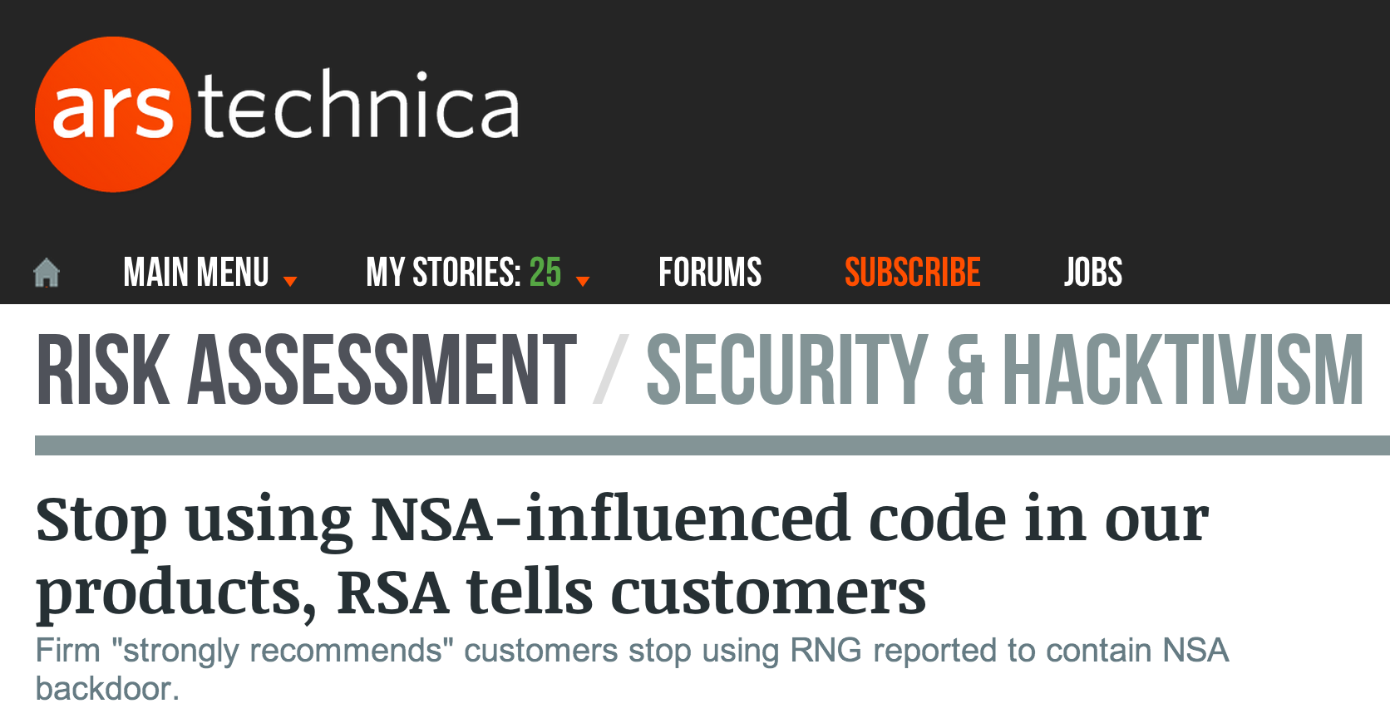
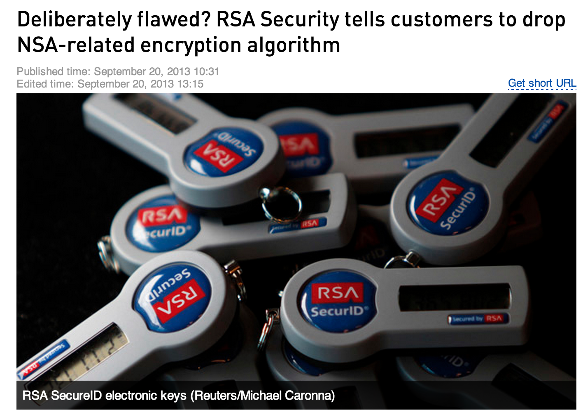
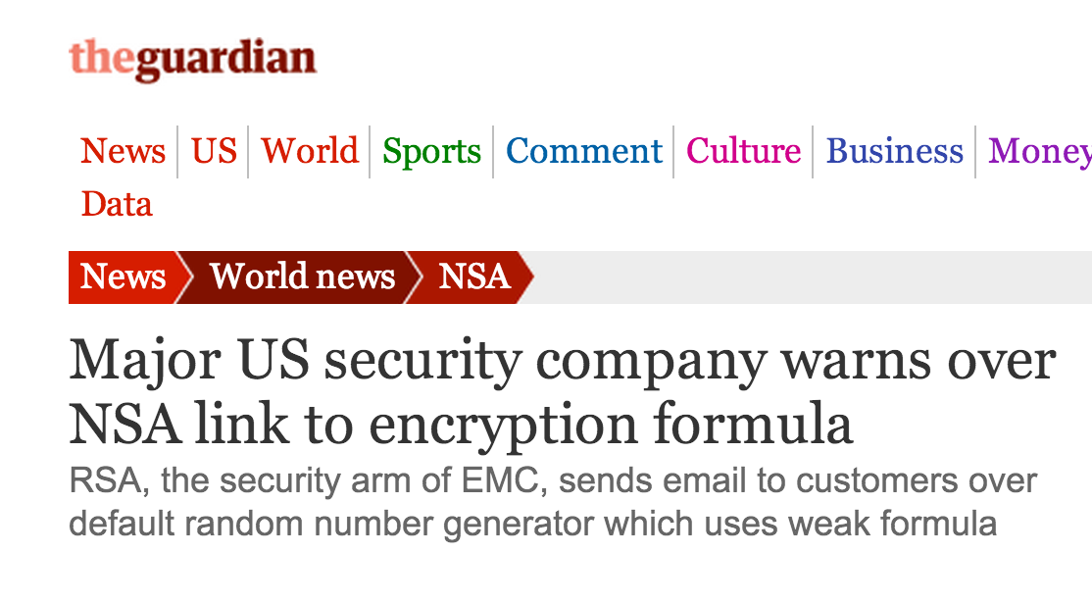
September 2013

Slide 44
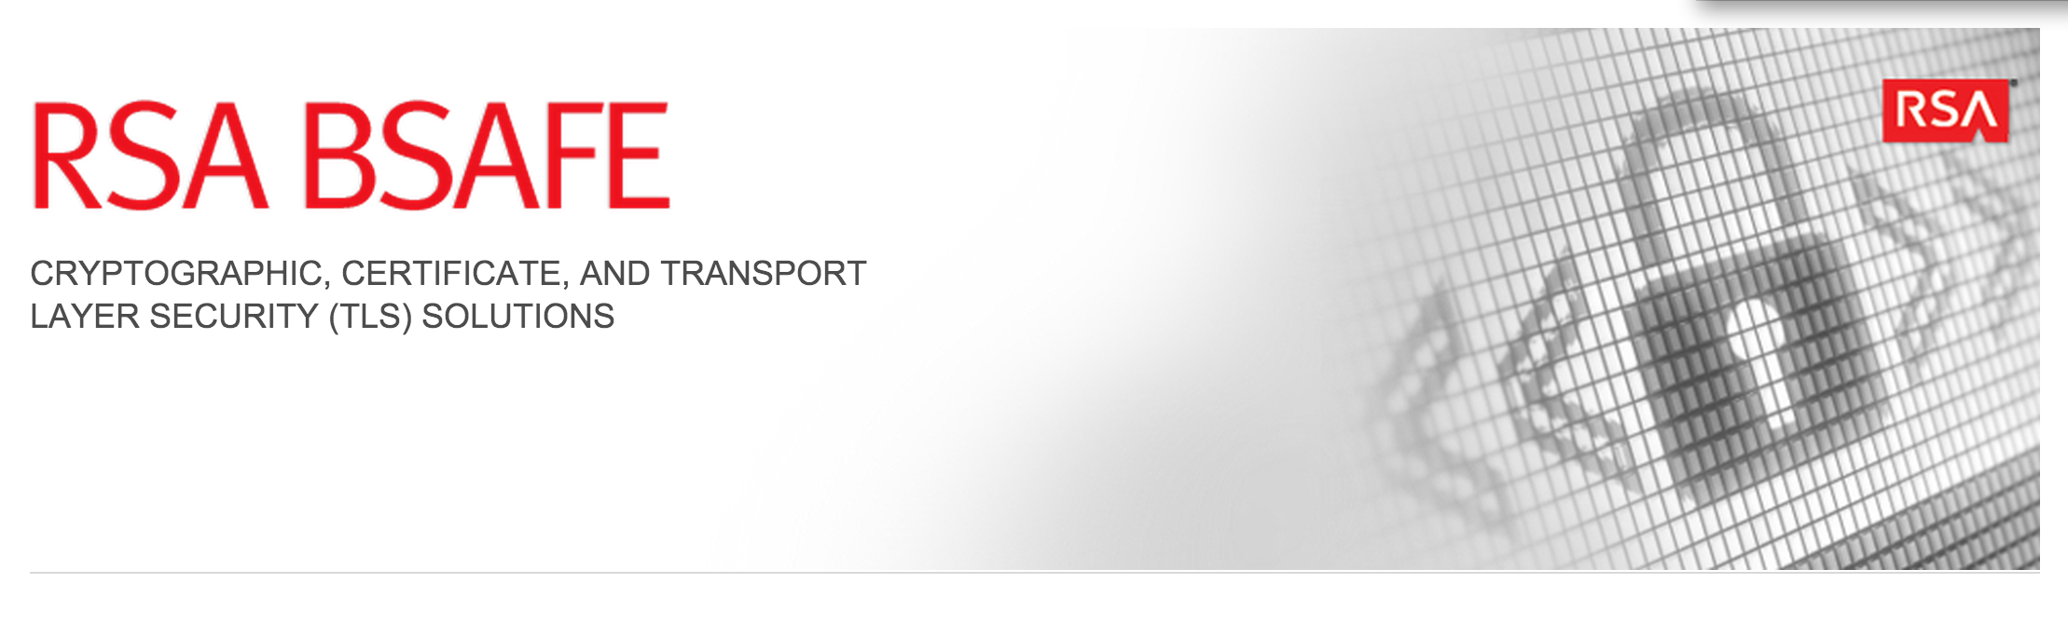
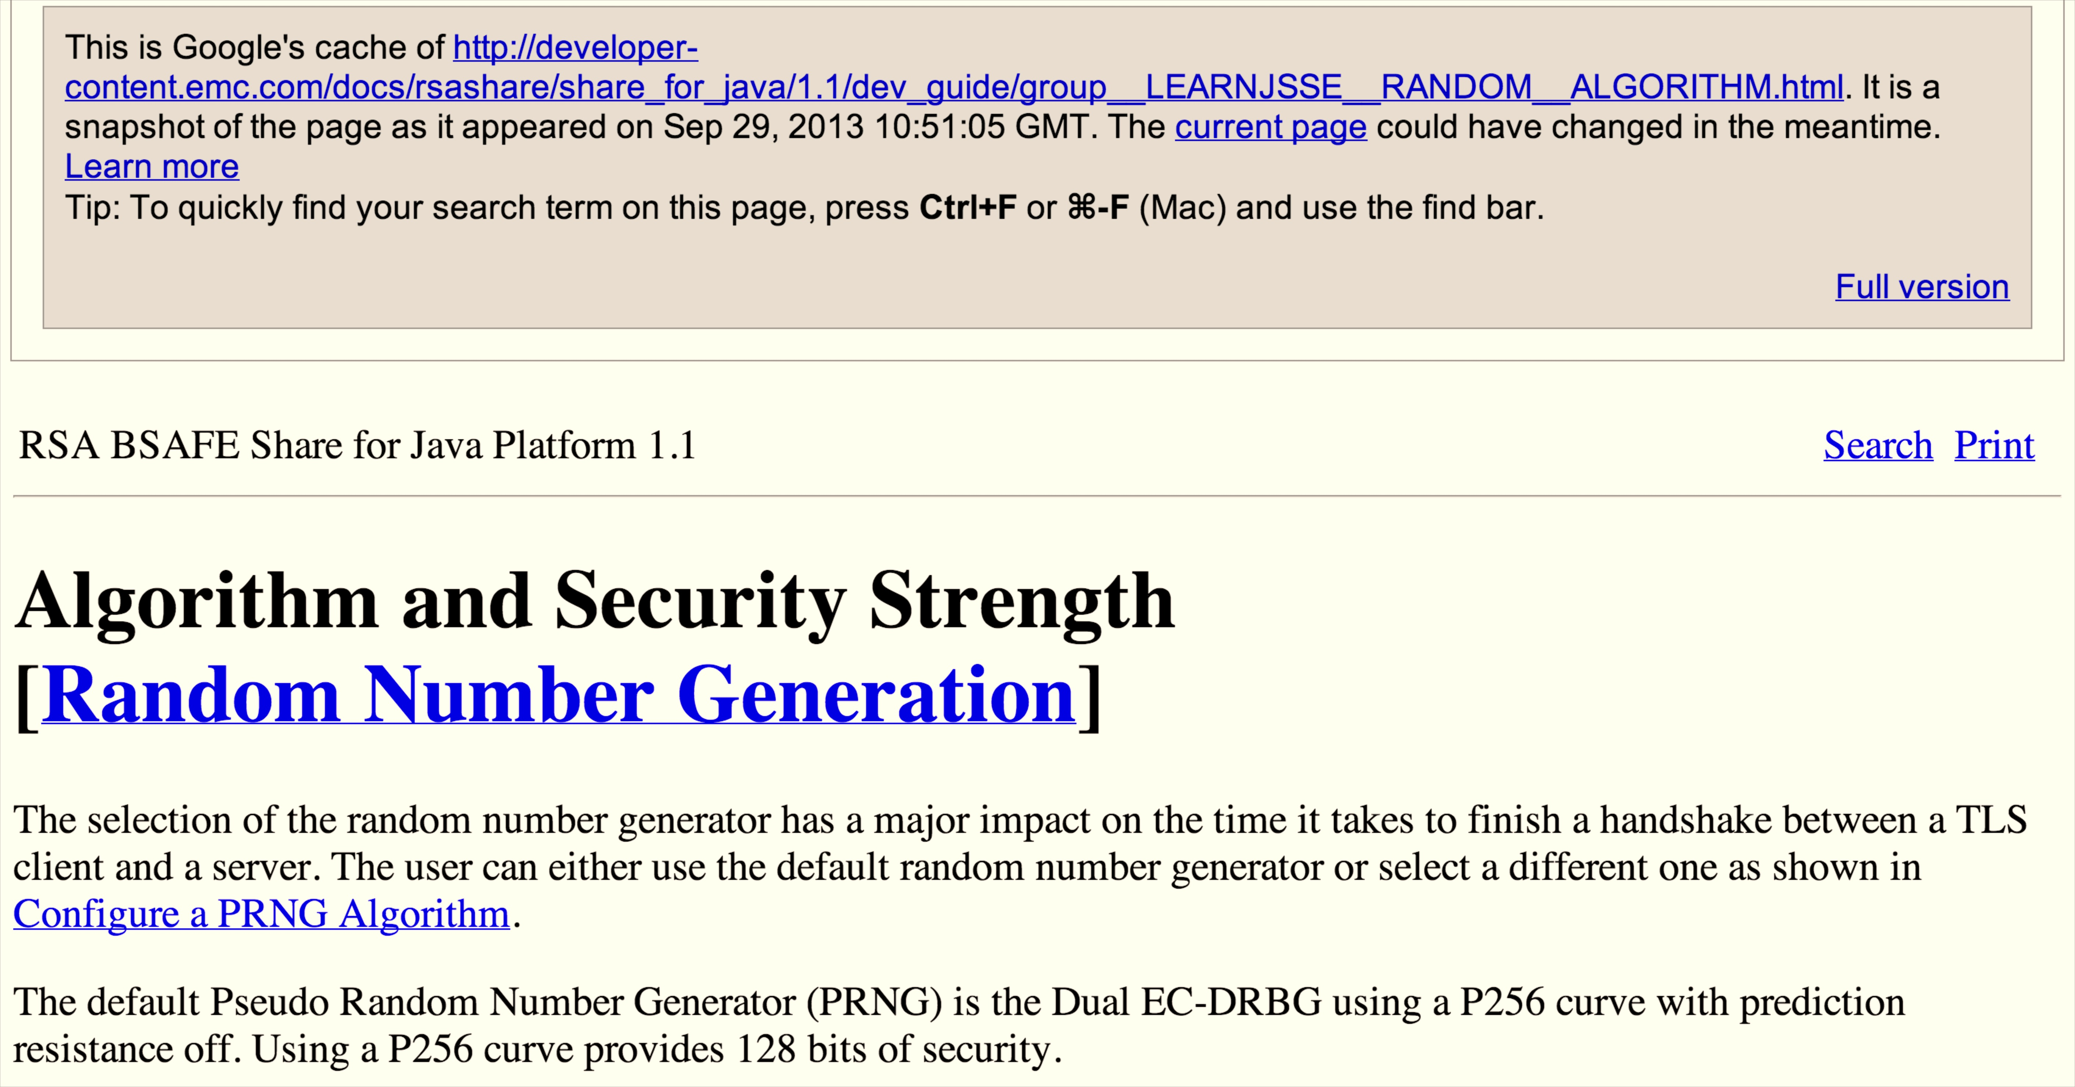

Slide 45
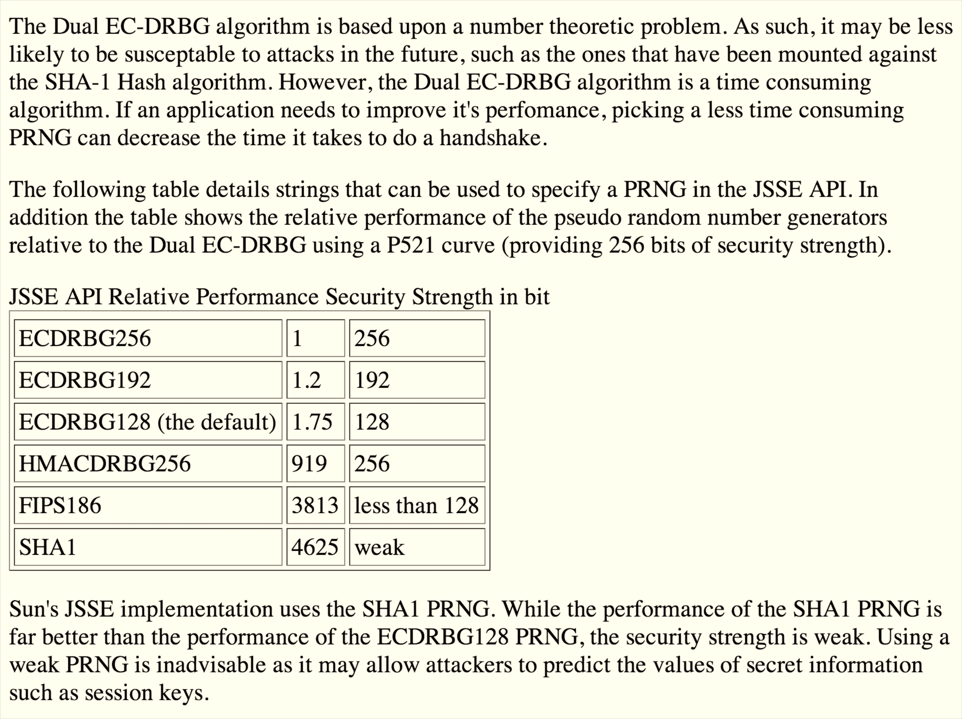

Slide 46
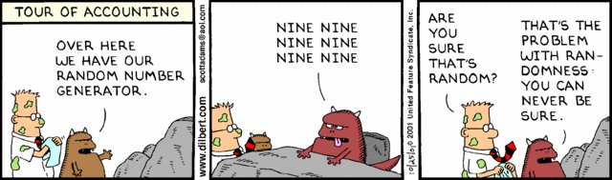
Randomness Summary
All cryptosystems depend on randomness
No way to test is a value is really random
Physical randomness is limited: need algorithms to amplify physical randomness
If you pseudorandom numbers are predictable, all is (almost always) lost

